Slide 1

DEPARTMENT OF INFORMATION SCIENCE & ENGINEERING
“ONLINE RETAIL SHOP”
COURSE NAME : MINI PROJECT
COURSE CODE: 20ISE59A
Presented by, Under the Guidance of,
NAME-SURAJ ANTONY RAJ A & HARINATH REDDY Dr. Arvind S. Kapse
USN-1NH20IS173 & 1NH20IS193 Professor,ISE

Slide 2
Agenda
Introduction
Limitations of Existing System
Problem Definition
Proposed system
Objectives
Design modules
Algorithm / Flow chart
Conclusion

Slide 3
Introduction
Web technology refers to the means by which computers communicate with each other using markup languages and multimedia packages. It gives us a way to interact with hosted information, like websites.
In computing, a web application or web app is a client-server computer program which the client runs in a web browser.
This is an user friendly website created for online purchase of Retail goods.
User is able to manage their purchase based on their needs at their own ease
Payment methods are also feasible for the purchases.

Slide 4
Limitations of Existing Systems
Compulsory registration for SHOPPING.
Some items are difficult to find online.
Takes time to deliver the products.
Security and safety issues

Slide 5
Problem Definition
In the existing stores all the work is done manually and setting up stalls require a lot of space.
Billing system involves usage of paper which might not be economic.
It is a time consuming process to get to the stores and find the necessary items and transportation of goods involves risk of damage to the products.

Slide 6
Objectives
to provide a safe and secured shopping platform at the ease of customer.
Faster delivery of goods.
Reliable mode of payments and shopping interface.

Slide 7
Design Modules
LOGIN MODULE: If a user has already created account he/she can login providing necessary inputs.
REGISTER MODULE: If the user wishes to use the website then they must register to it providing necessary credentials. Creates an account in the website in the name of the user.
ORDERING MODULE: The users can add the items available in the website to their shopping cart and can add or remove any items later based on their choice.
PAYMENT MODULE: After the user wishes to check out their shopping cart, they must proceed to the payment module by choosing the feasible mode of payment.

Slide 8
Algorithm
Step1:start
Step2: create an user account using the website by entering the required details.
Step3:if the account is already created login to the website entering credentials.
Step4:add or delete items to the shopping cart as required.
Step5:continue to the payment module after the purchase.
Step6:end

Slide 9
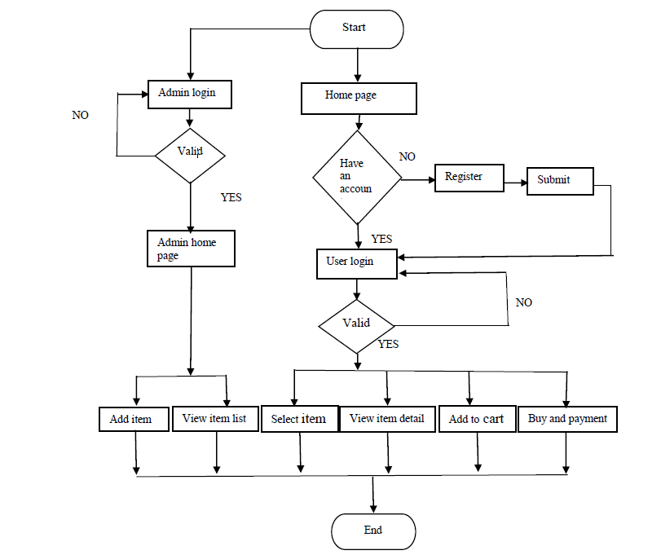
flowchart

Slide 10
Conclusion
The proposed website can be used to deliver goods at the ease of the user and also can be time saving.
There seems a rapid growth in the use of online applications and websites for shopping these days due to busy daily schedules thereby creating a trend of online shopping.
Online shopping has also become one of the convenient ways to the users.
This project helped is in gaining knowledge on topics like HTML,CSS and PHP, JavaScript and management of MySQL .

Slide 11
References
J. Brownlee, “Introduction to the Python Deep Learning Library TensorFlow,” Machine Learning Mastery, May 04, 2016. https://machinelearningmastery.com/introductionpython-deep-learning-library-tensorflow/ (accessed Apr. 21, 2020).
“Home - Keras Documentation.” https://keras.io/ (accessed Apr. 21, 2020). [24] “Project Jupyter.” https://www.jupyter.org (accessed Apr. 19, 2020).
K. Team, “Keras documentation: Search Keras documentation.” https://keras.io/search.html?query=lstm (accessed Jul. 07, 2020).
K. Joshi, kartik-joshi/Stock-predection. 2020.
K. Team, “Keras documentation: The Sequential model.” https://keras.io/guides/sequential_model/ (accessed Jul. 07, 2020). Market Prediction Using Machine Learning,” in 2018 First International Conference on Secure Cyber Computing and Communication (ICSCCC),

Slide 12
Thank you

